Slide 1
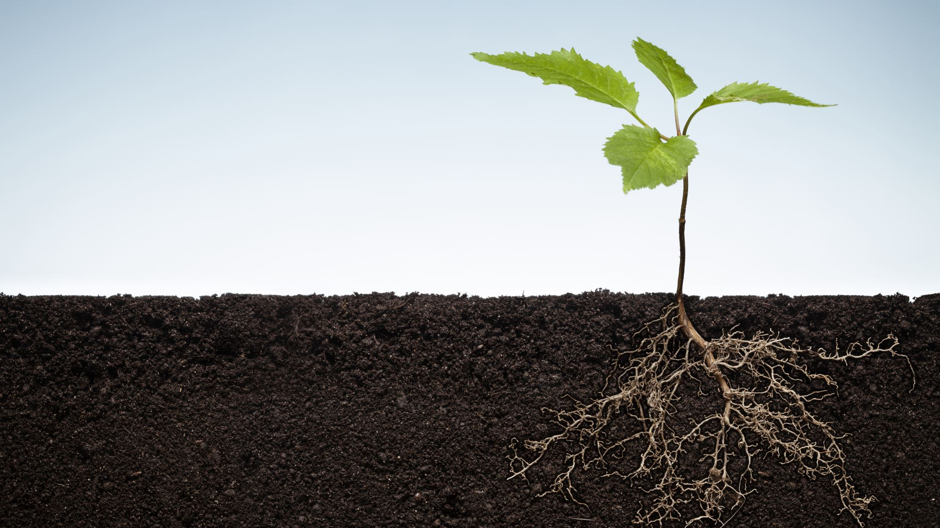
Mid Project Submission PLANT DISEASE CLASSIFICATION BY: NEURAL NINJAS

Slide 2
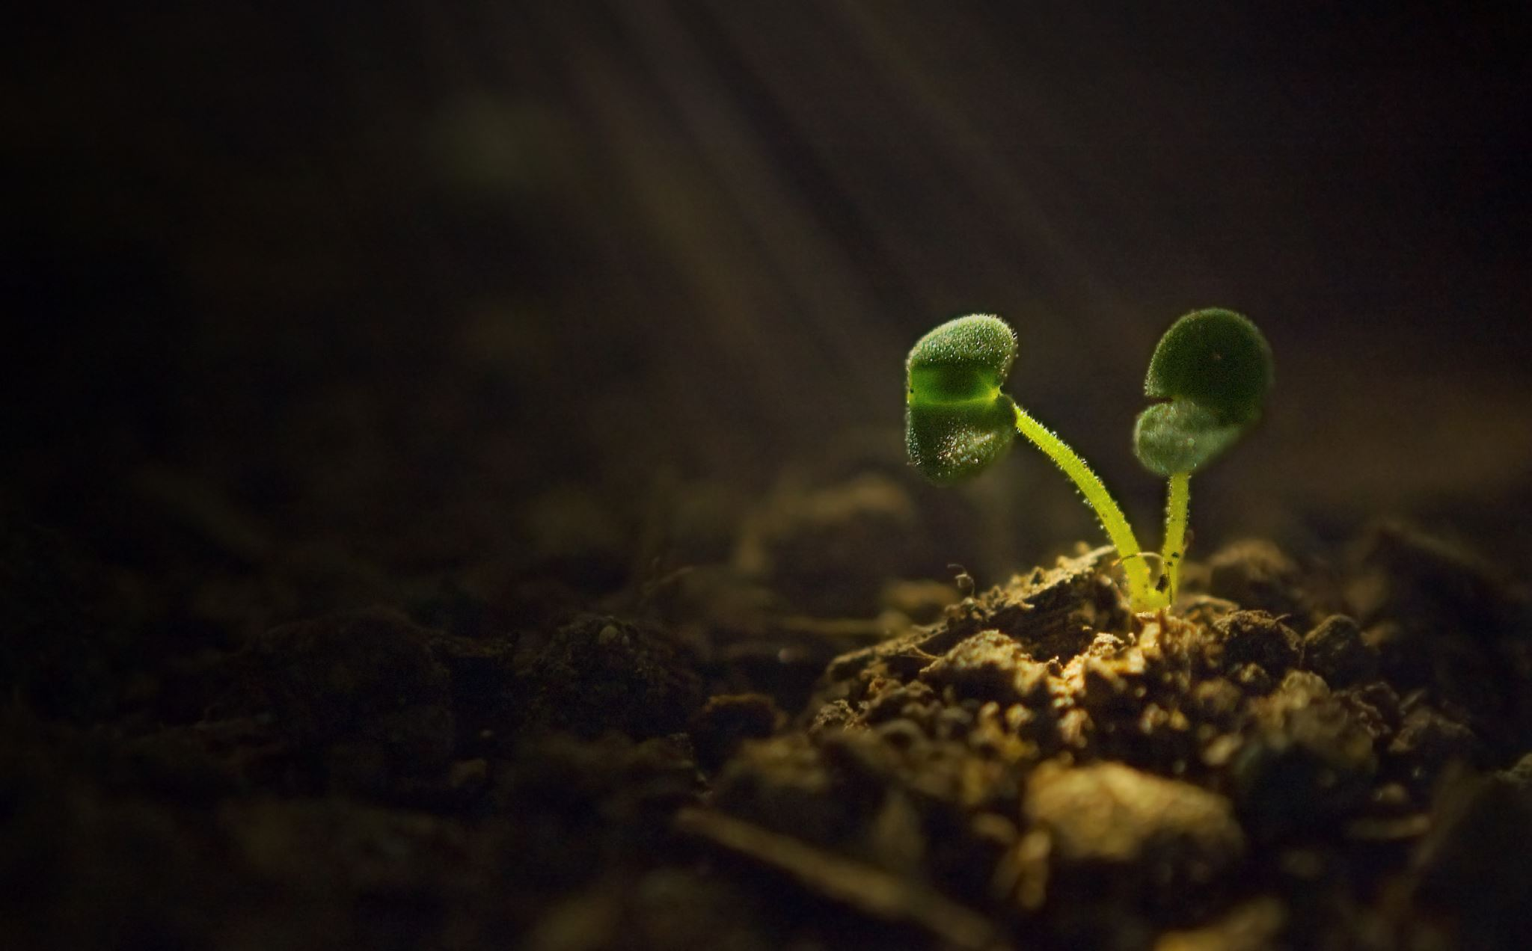
1.INTRODUCTION 2. EDA PRESENTATION 3.IMPLEMENTATION 4. RESULTS 5. FUTURE SCOPE & IMPROVEMENTS
CONTENTS

Slide 3
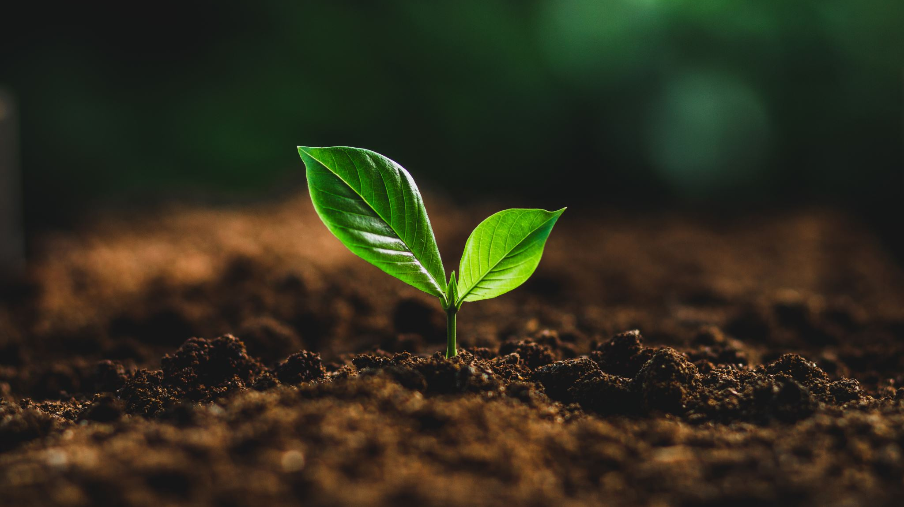
1. INTRODUCTION AND PROBLEM STATEMENT

Slide 4

PROBLEM STATEMENT
Plant diseases can cause significant damage to crops, leading to financial losses for farmers. Solution: Develop a machine learning model that can accurately classify plant diseases from images, allowing farmers to take preventive measures early on. OBJECTIVES: 1.To identify the plant disease. 2.To classify the plant disease. 3.To predict the severity of the plant disease. 4.To track the spread of the plant disease. 5.To develop new treatments for plant diseases.

Slide 5
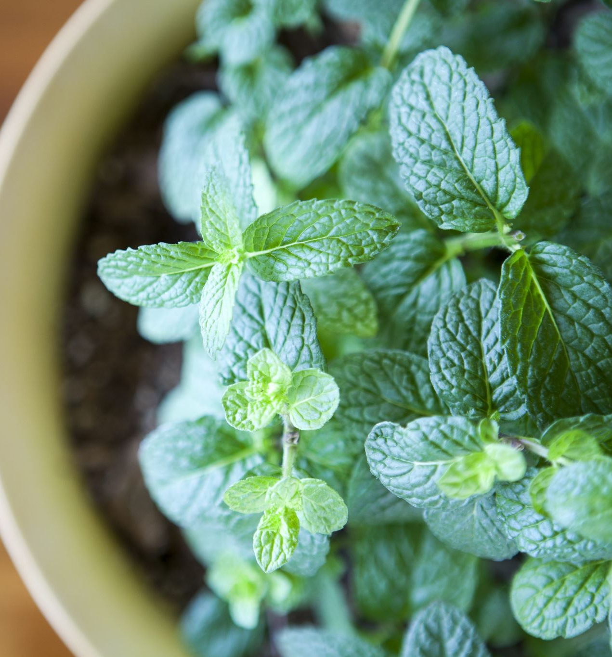
CONSTRAINTS
1.Accuracy
2.Computational Resources
3.Generalization
4.Interpretability

Slide 6

ROADMAP
1.Data collection
2.Data preprocessing
3.Model training
4.Model evaluation
5.Model deployment

Slide 7
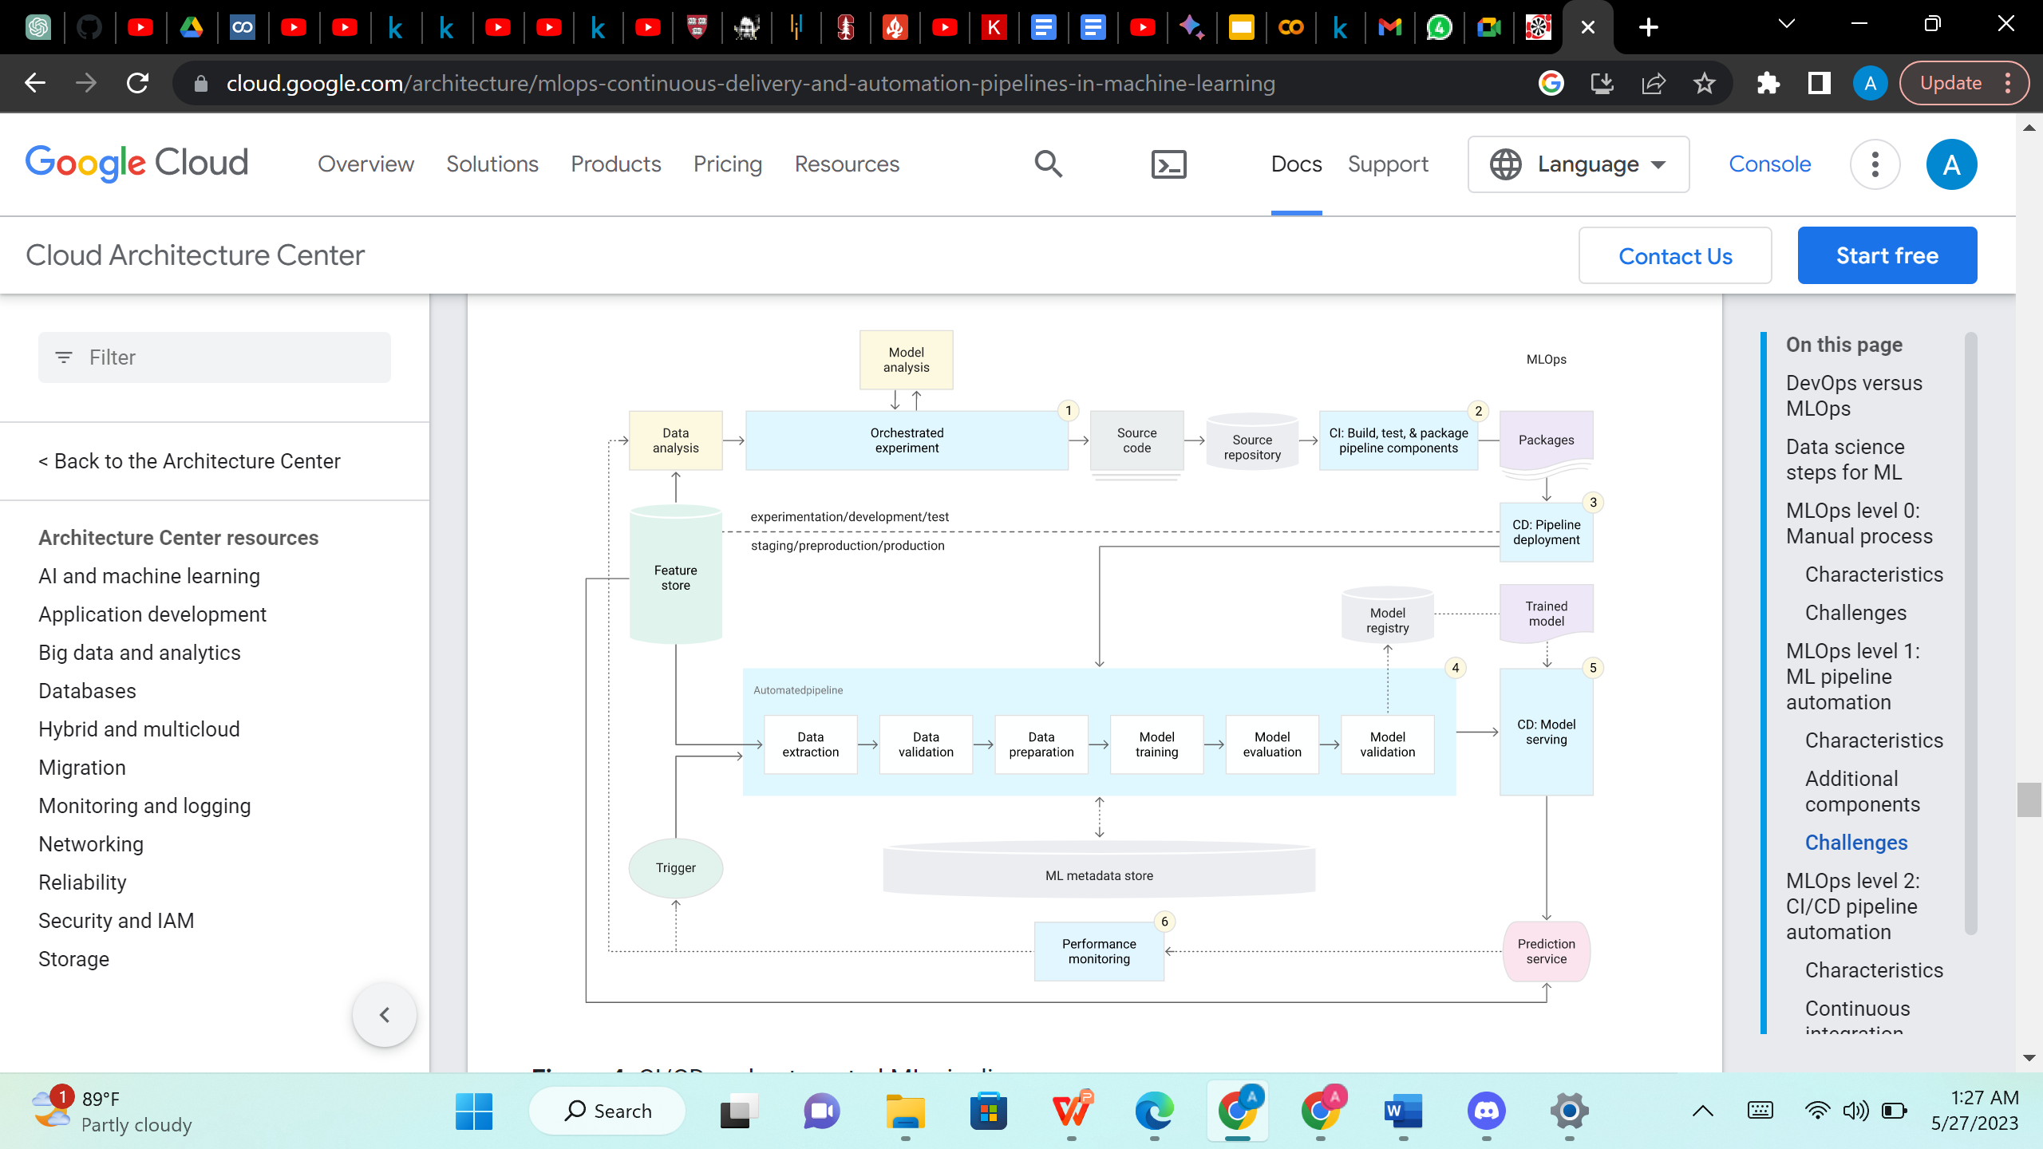
ARCHITECTURE

Slide 8
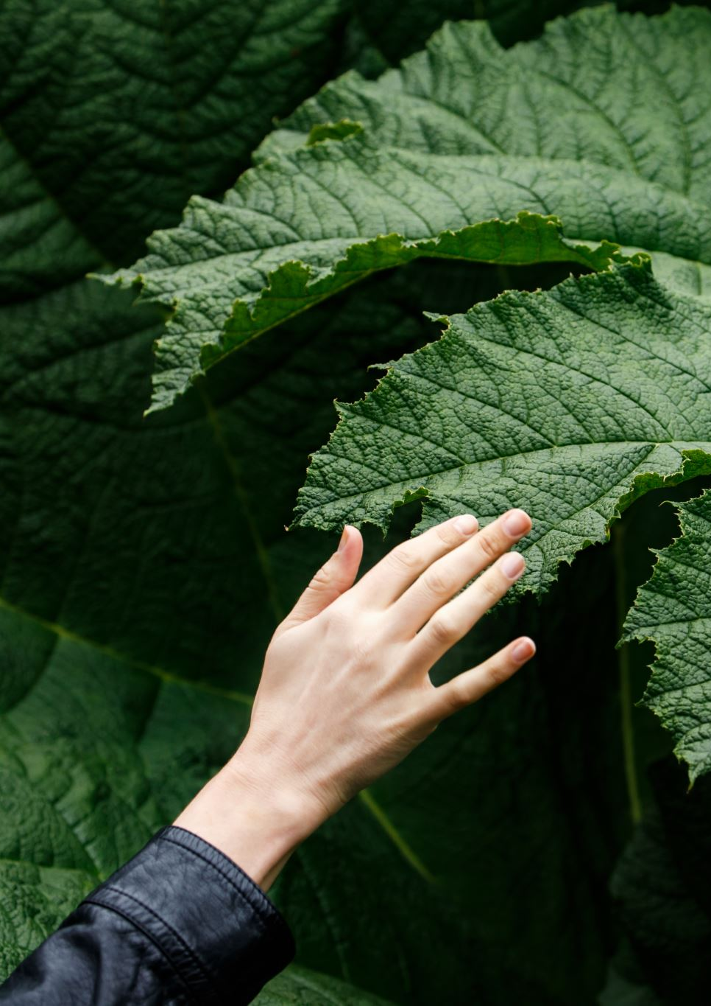
PROPOSED APPROACH
In the pursuit of plant disease classification, we have explored different models, including convolutional neural networks (CNNs), with a particular focus on ResNet and VGG16.
CNNs are specialized deep learning algorithms for image classification, enabling them to recognize patterns and categorize images accordingly.
ResNet, a powerful CNN architecture, excels in capturing long-range dependencies within images, making it ideal for complex or diverse plant disease classification tasks.
VGG16, another effective CNN model, specializes in learning local features in images, making it well-suited for classifying detailed or simpler plant disease images.
By considering and experimenting with these CNN models, we aim to devise an optimal approach for accurate plant disease classification.

Slide 9
2. EDA PRESENTATION

Slide 10
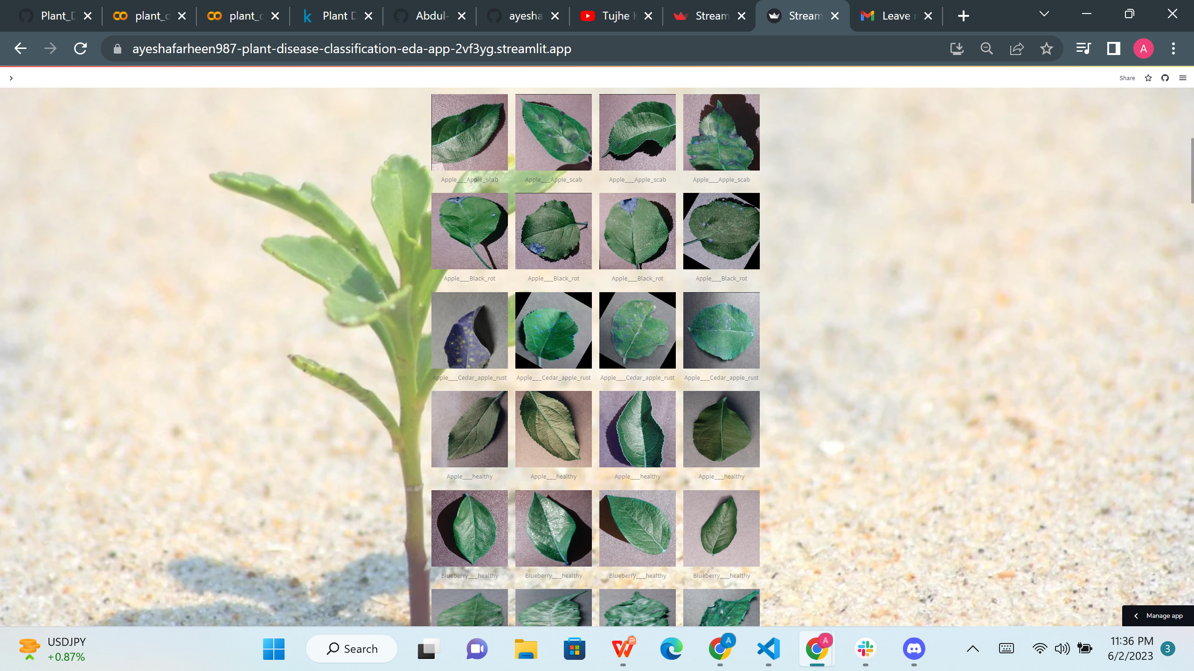
DATASET OVERVIEW AND CHARACTERISTICS
Dataset recreated using offline augmentation from the original dataset
Contains approximately 87,000 RGB images of healthy and diseased crop leaves
Categorized into 38 different classes
Training and validation set divided in an 80/20 ratio while preserving the directory structure
Additional directory created for prediction purposes containing 33 test images

Slide 11
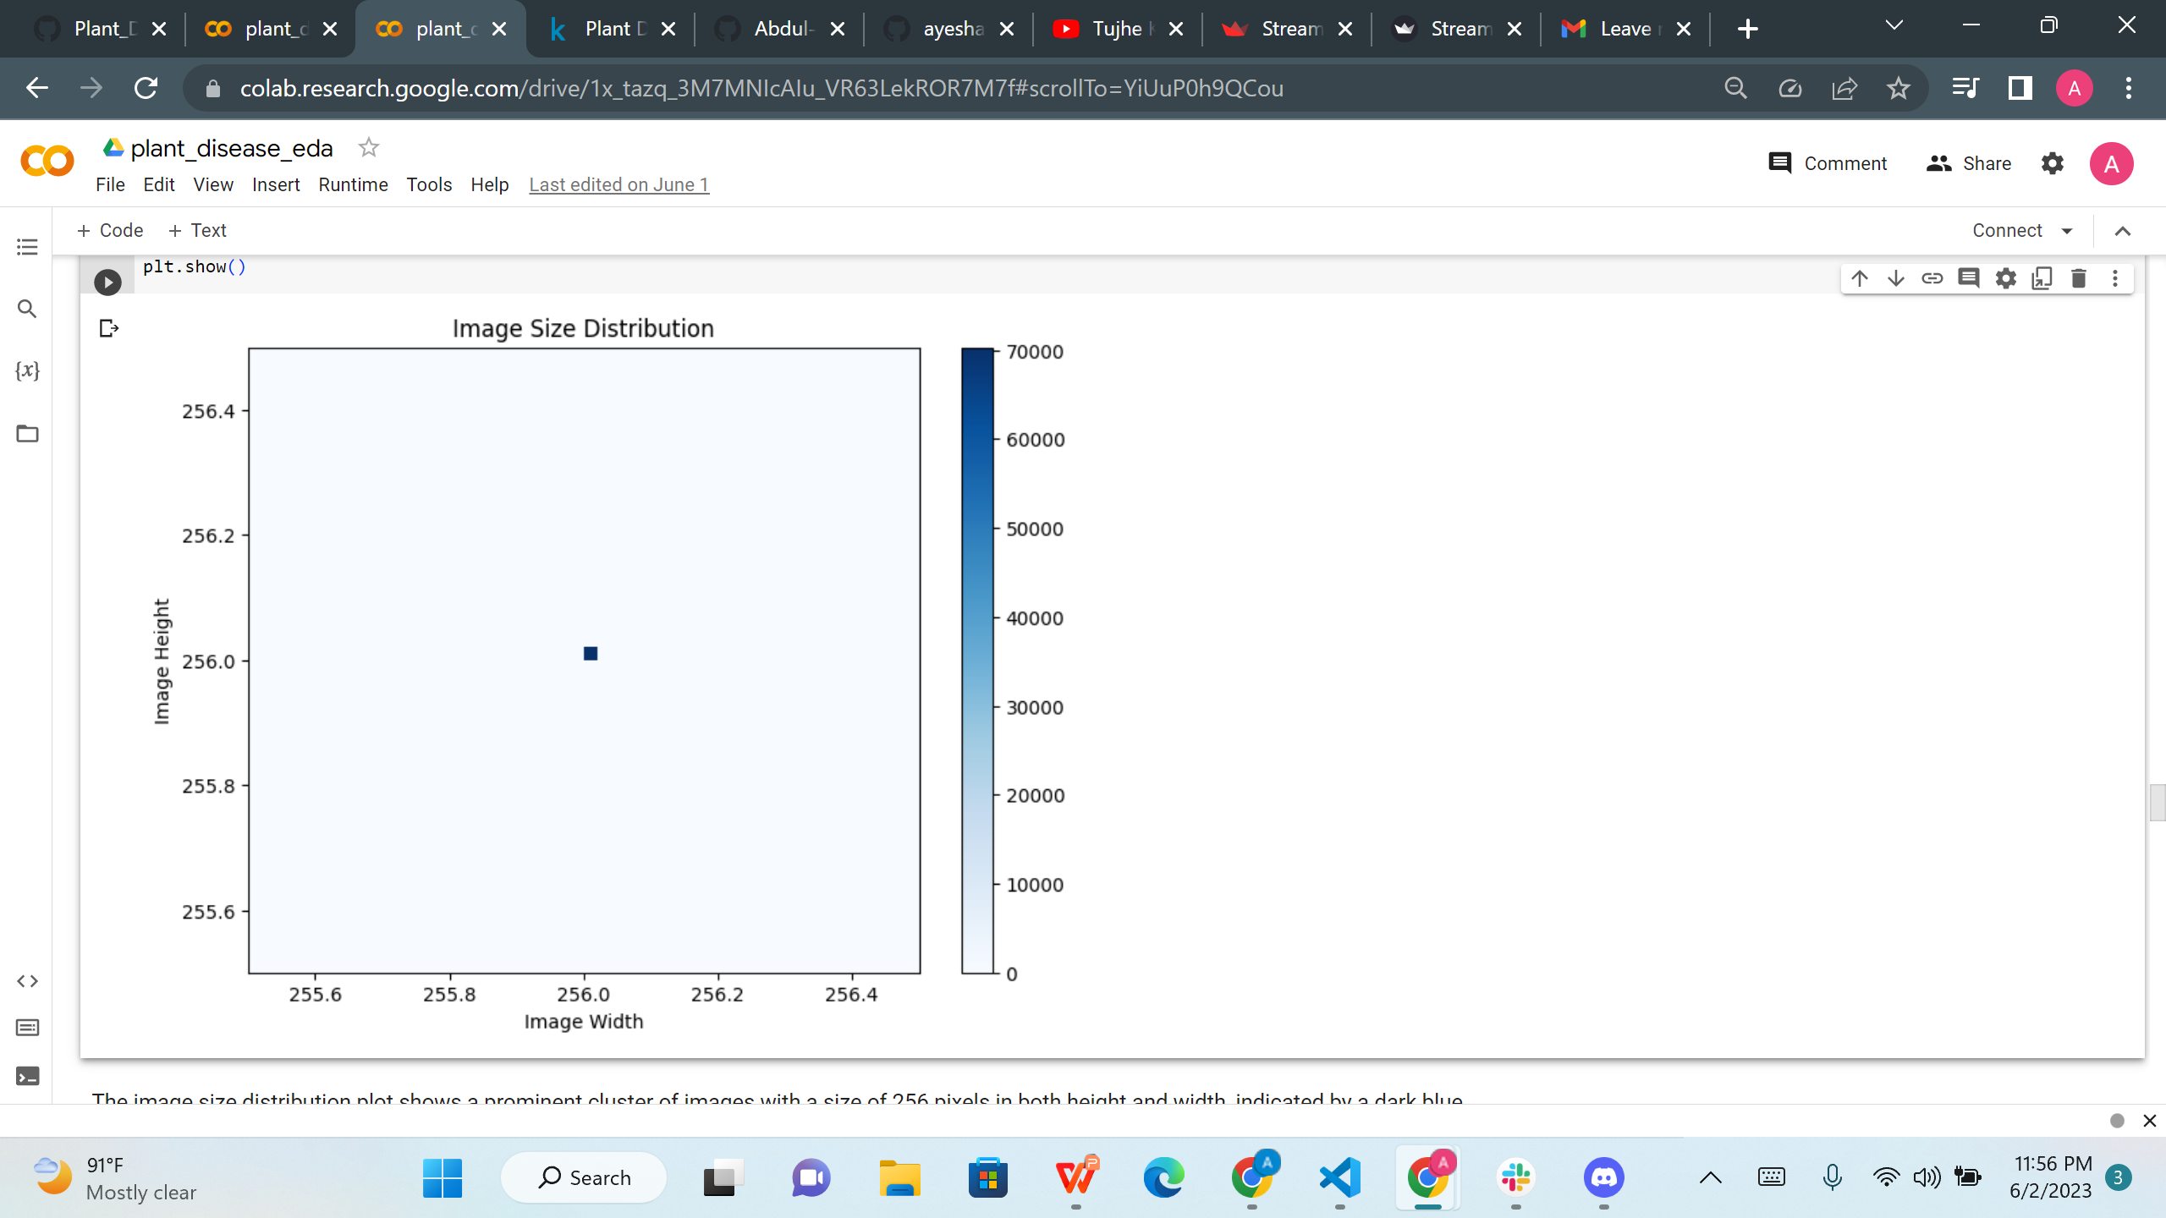
IMAGE SIZE DISTRIBUTION
The image size distribution plot reveals a prominent cluster of images with a size of 256 pixels in both height and width, represented by a dark blue dot.
This indicates that a significant portion of the dataset consists of images with consistent dimensions.
The dataset has an average of 3 channels per image, indicating that the images are in RGB format.
The average image resolution of approximately 2.67 indicates a consistent resolution across the dataset.
Understanding the image size distribution, channel information, and resolution can inform preprocessing techniques and model architectures suited for these specific characteristics.

Slide 12
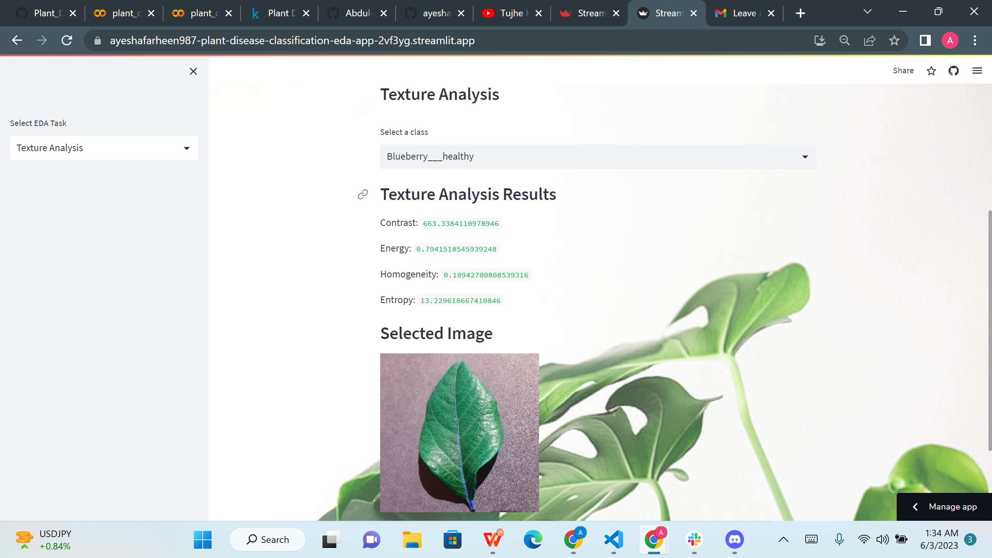
TEXTURE ANALYSIS IN IMAGE QUALITY ASSESSMENT
Texture analysis plays a crucial role in evaluating the visual quality of images.
It focuses on identifying patterns and textures within an image.
Code Implementation and Results:
Perform texture analysis on selected images using the Haralick method.
Compute texture features: contrast, energy, homogeneity, and entropy.
These features provide insights into image characteristics.
Display the computed results for each feature.

Slide 13
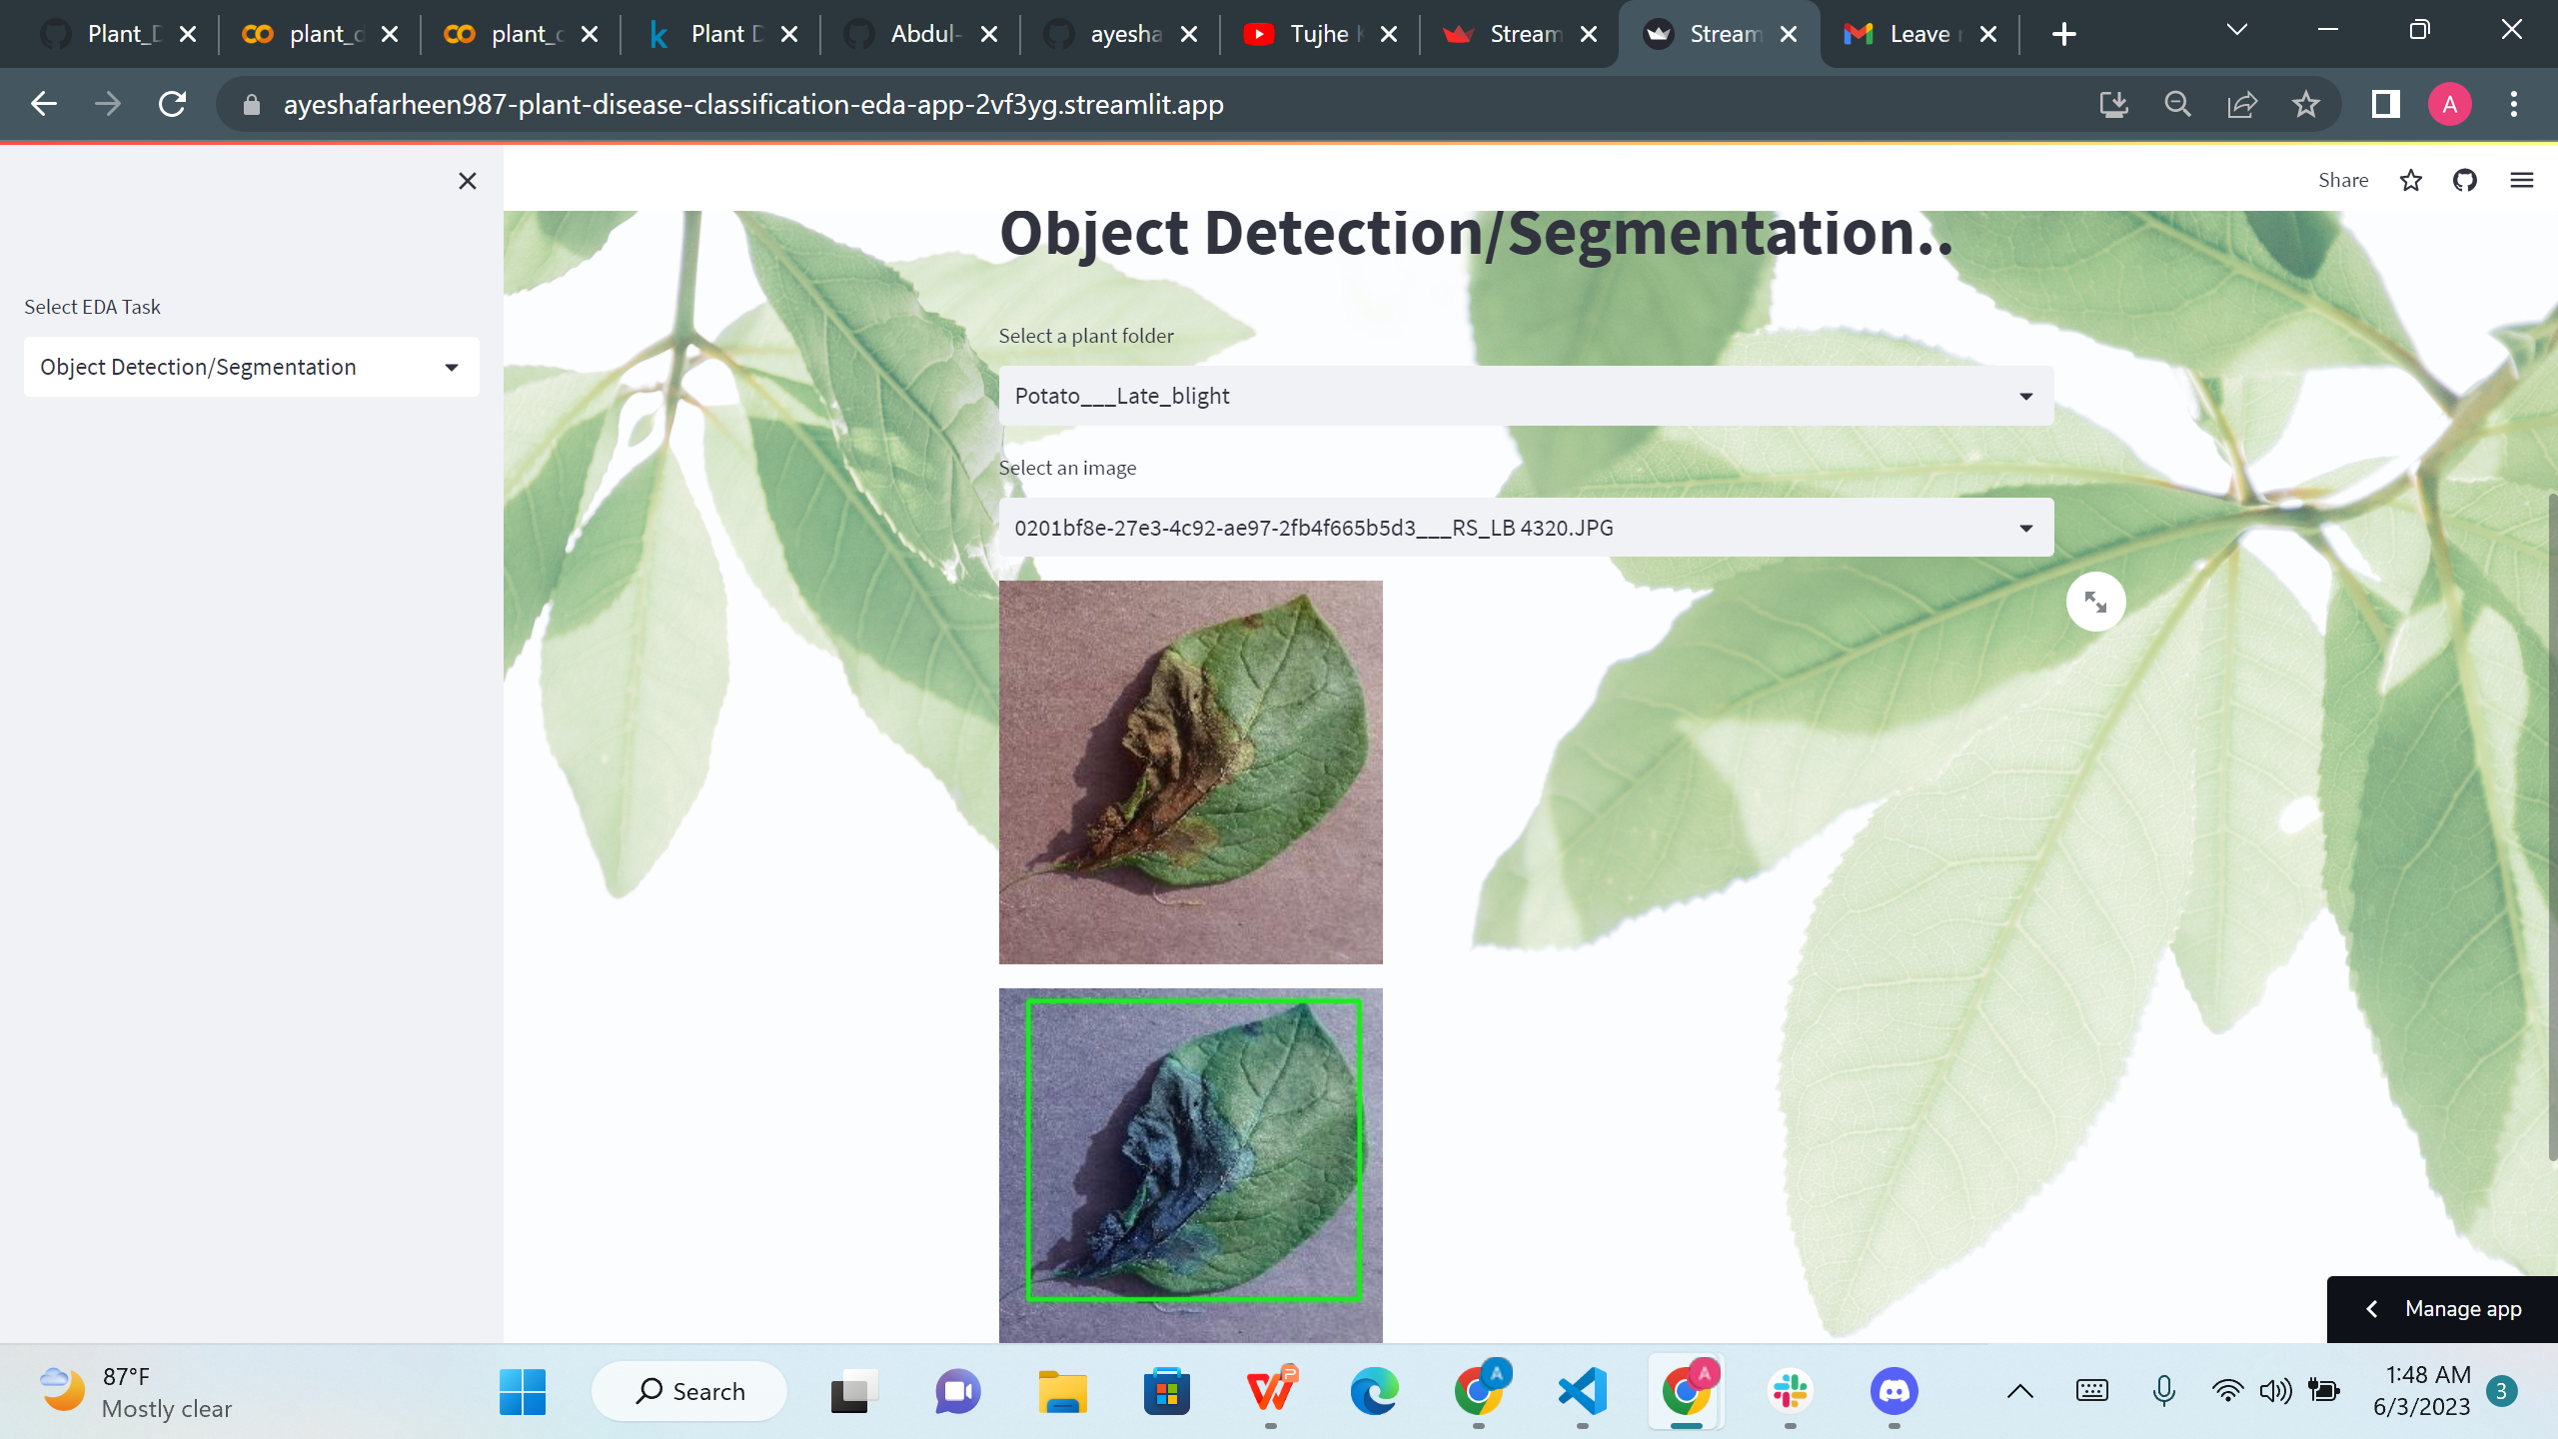
Object Detection using Pre-trained Model
Object detection plays a crucial role in analyzing plant diseases through computer vision.
Utilizing a pre-trained model, we performed object detection to identify and locate diseased parts within plant images.
Code Implementation and Results:
Loaded a pre-trained Faster R-CNN model with ResNet-50 backbone.
Selected an image from the dataset for analysis.
Extracted bounding boxes, labels, and scores from the model's predictions.
Visualizing Detected Diseased Parts:
Highlighted the identified diseased parts using bounding boxes.
Displayed the image with the highlighted regions.

Slide 14
3. RESULTS

Slide 15
RESULTS
1. Alexnet 35 mins epochs 10 val_acc = 80 2. ResNet50 144 mins epochs 10 val_acc = 85 3. Vgg16 350 mins epochs 10 val_acc = 88
4. MobileNet 140 mins epochs 04 val_acc = 93

Slide 16
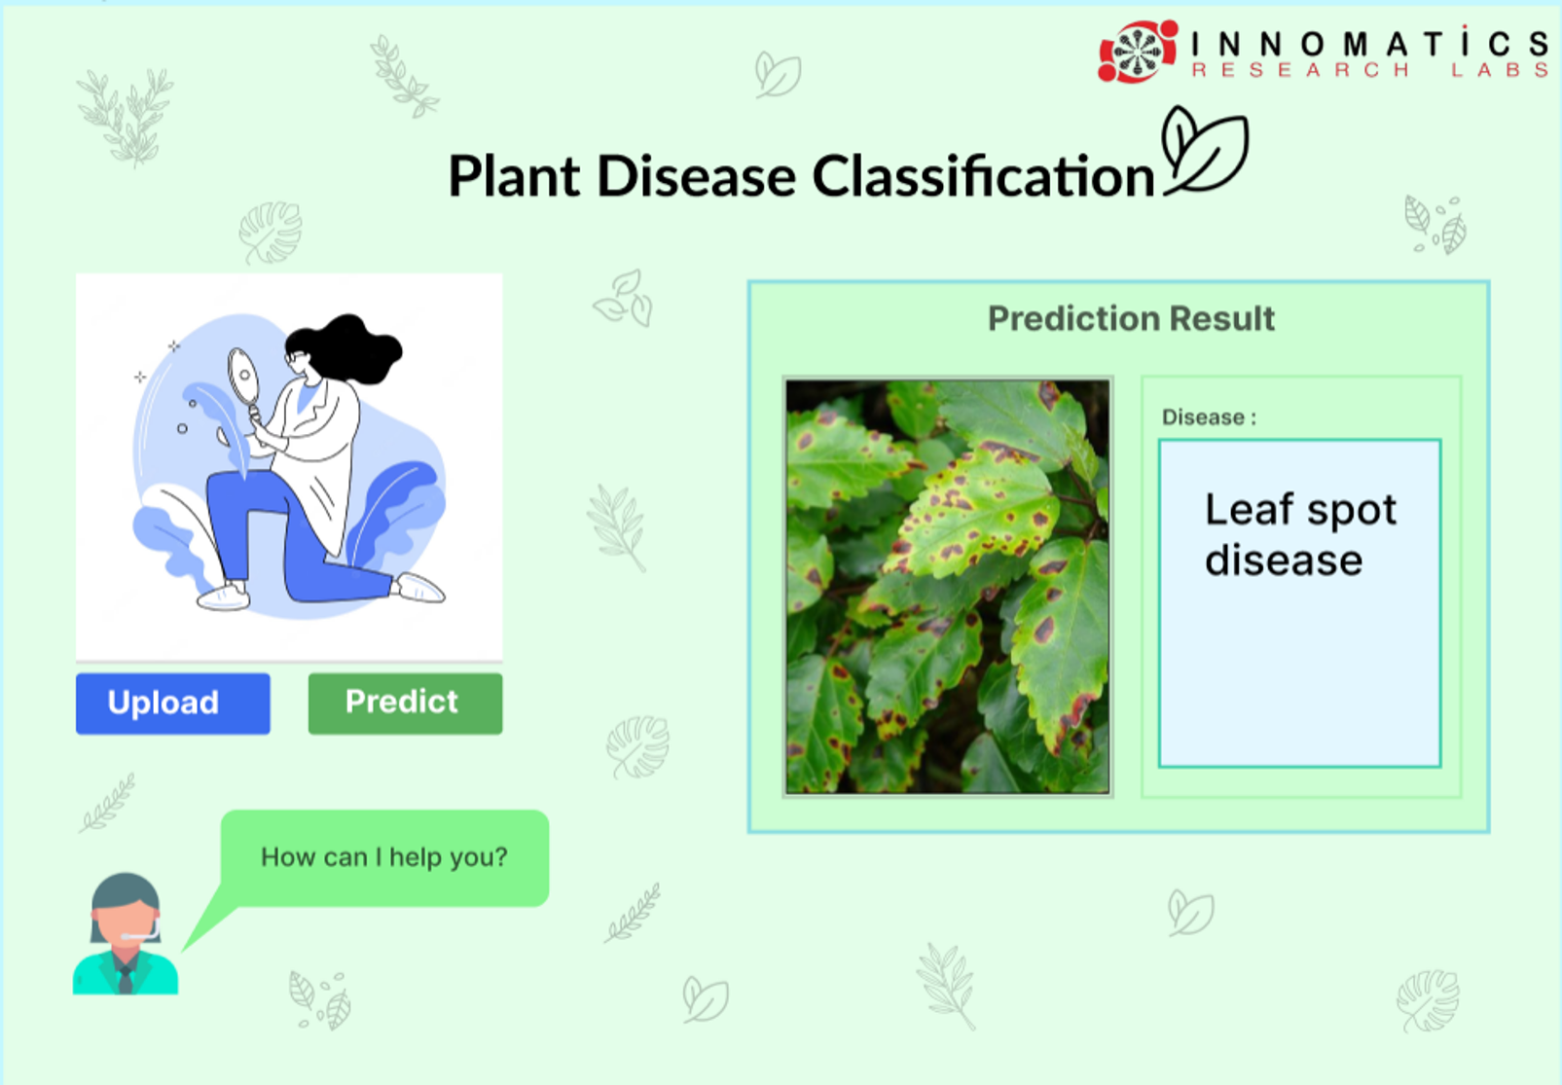
PROTOTYPE

Slide 17

PLANT CHAT BOT
1.Developed a question answering chatbot using GPT index and lang chain.
2.The chatbot provides comprehensive information on plant diseases, including diseases affecting various plants.
3.Offers detailed descriptions, symptoms, and factors contributing to disease development.
4.Provides recommendations for reducing the impact of plant diseases through preventive measures and treatment plans.

Slide 18
5. FUTURE SCOPE & IMPROVEMENTS

Slide 19
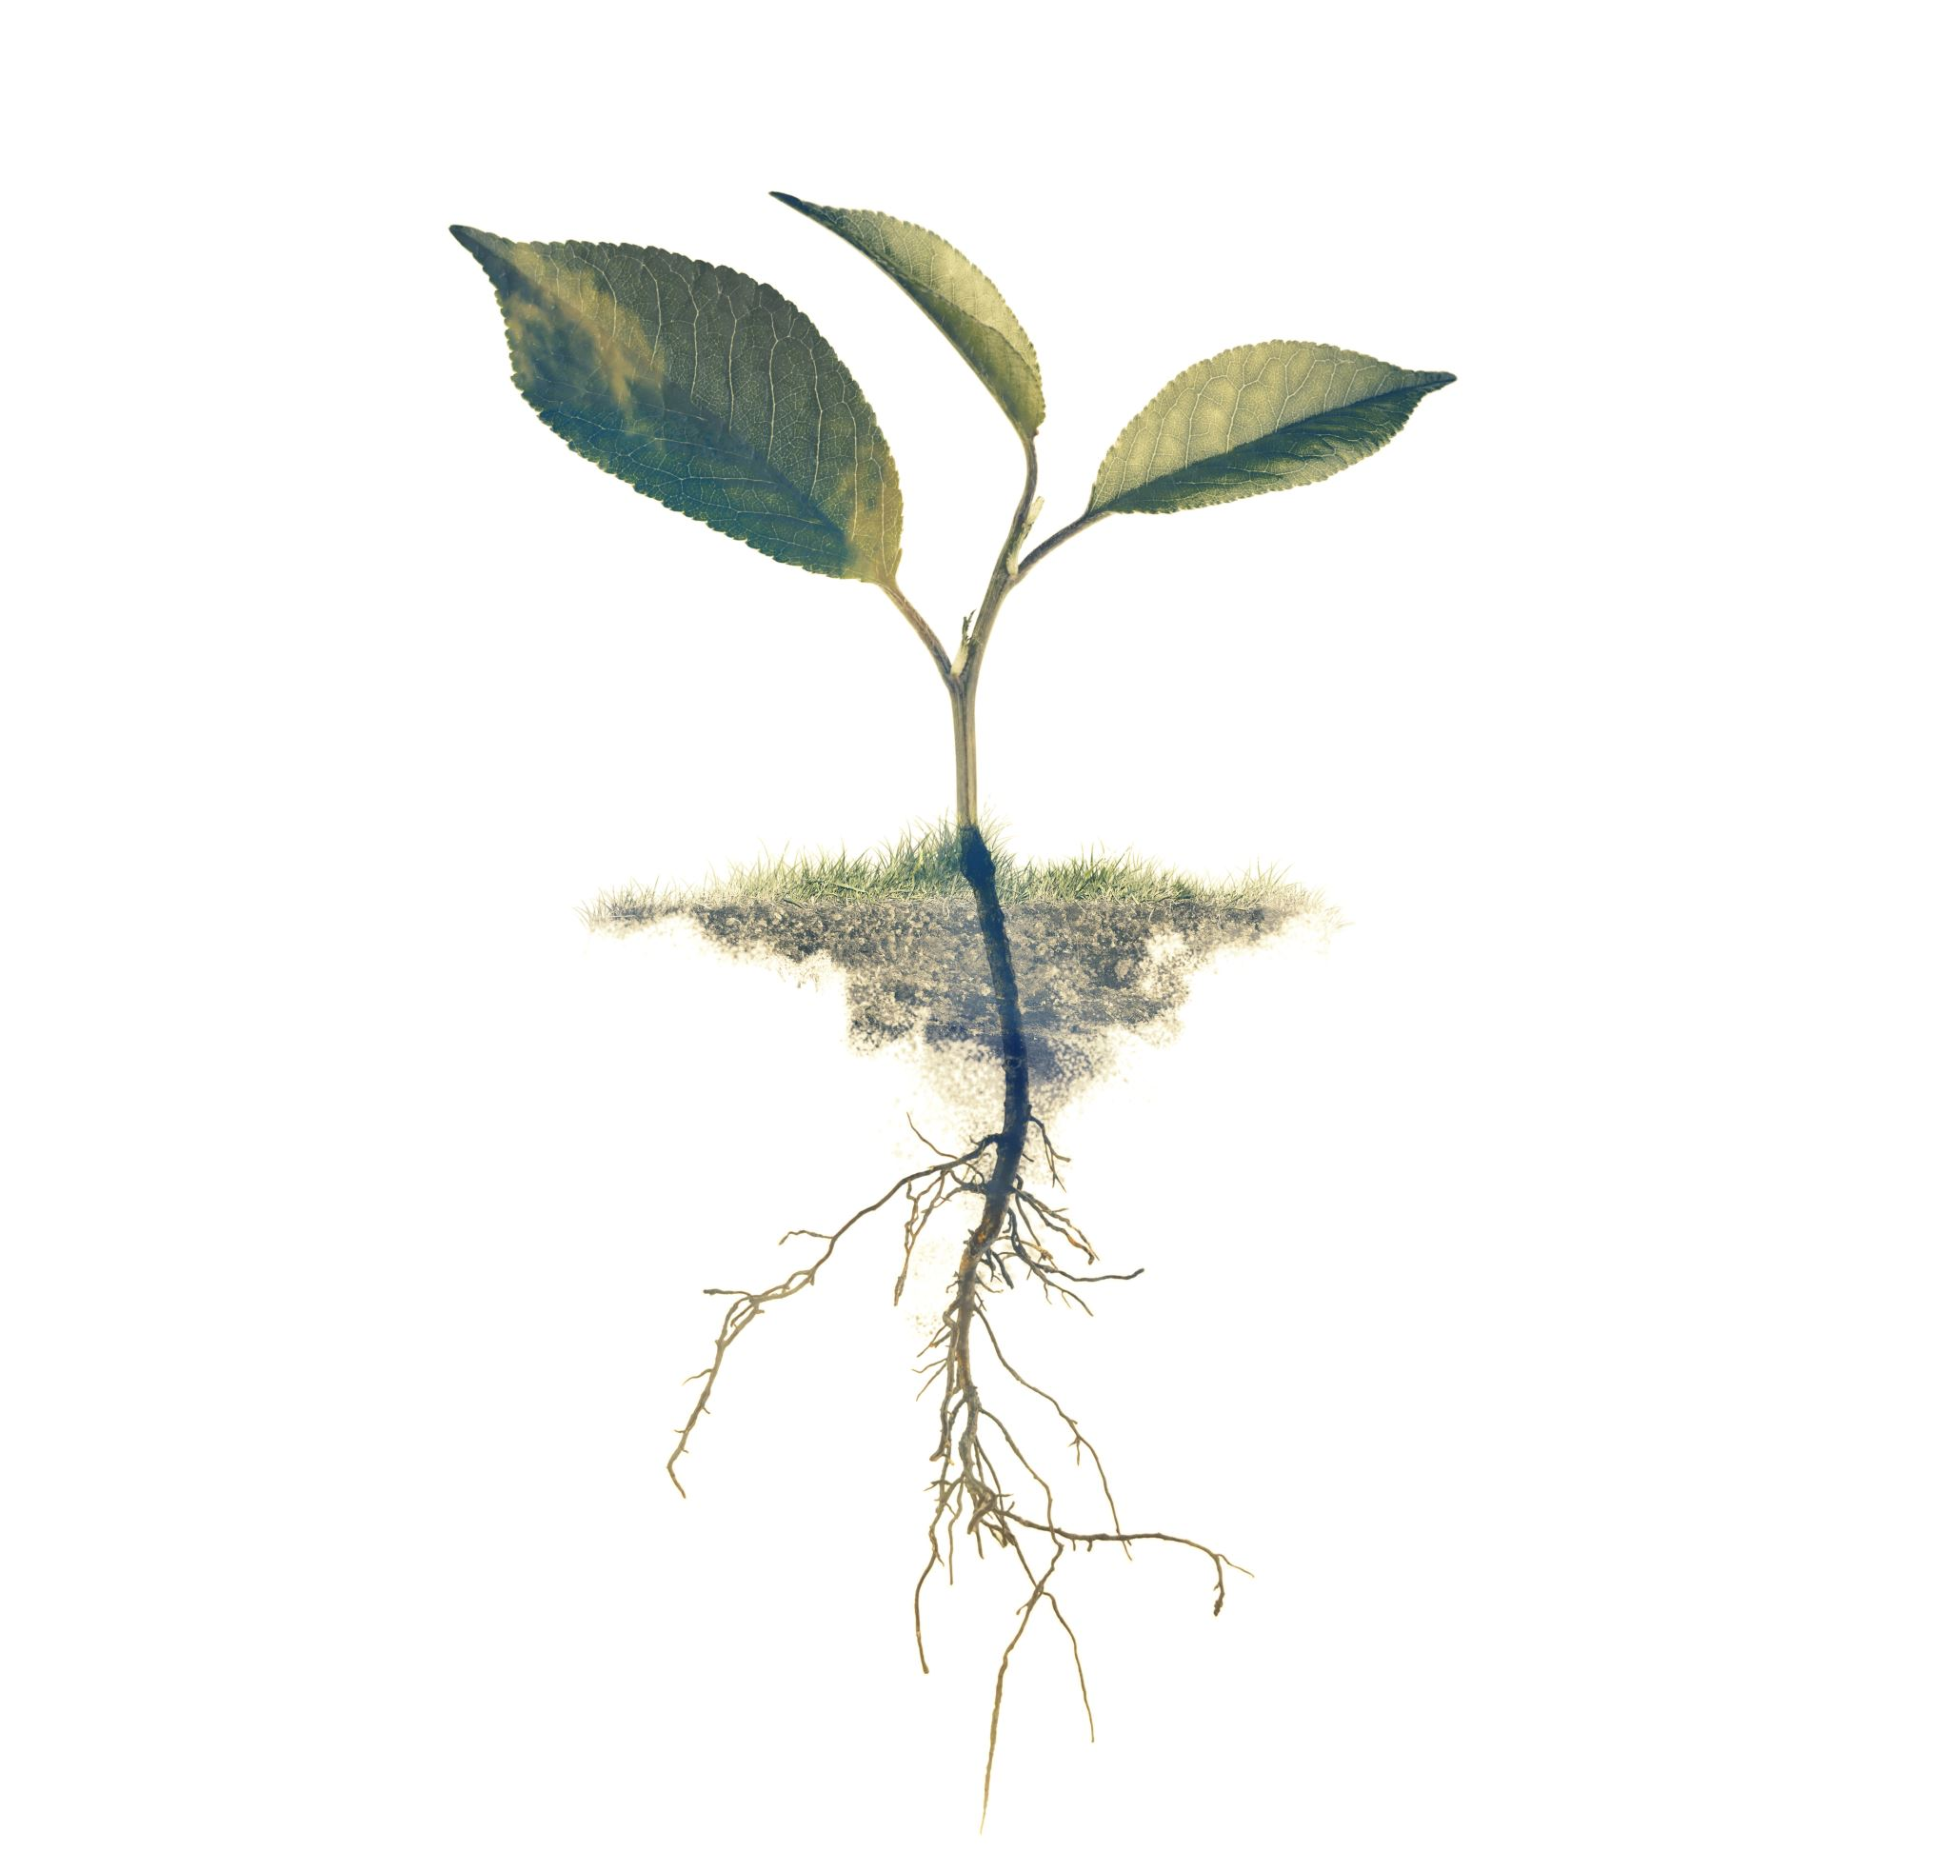
5. FUTURE SCOPE & IMPROVEMENTS
1.Converting into microservices architecture.
2.Deploying full dataset with models in AWS cloud platform.
3.Improving Chatbot.
4.Creating mobile application

Slide 20

CONCLUSION
In conclusion, We experimented with various convolutional neural network (CNN) architectures, including ResNet50, VGG16, AlexNet, and MobileNet. After comparing their performance, we found that MobileNet yielded the best accuracy with fewer epochs and less training time.By using MobileNet, we achieved higher accuracy in my task compared to the other pretrained models. Additionally, we also noticed that MobileNet required fewer epochs to reach convergence, meaning it reached optimal performance faster. Furthermore, the training process with MobileNet took less time, which can be beneficial when working with large datasets or limited computing resources. Overall, the combination of MobileNet's high accuracy, faster convergence, and shorter training time makes it an efficient choice for my specific task.

Slide 21
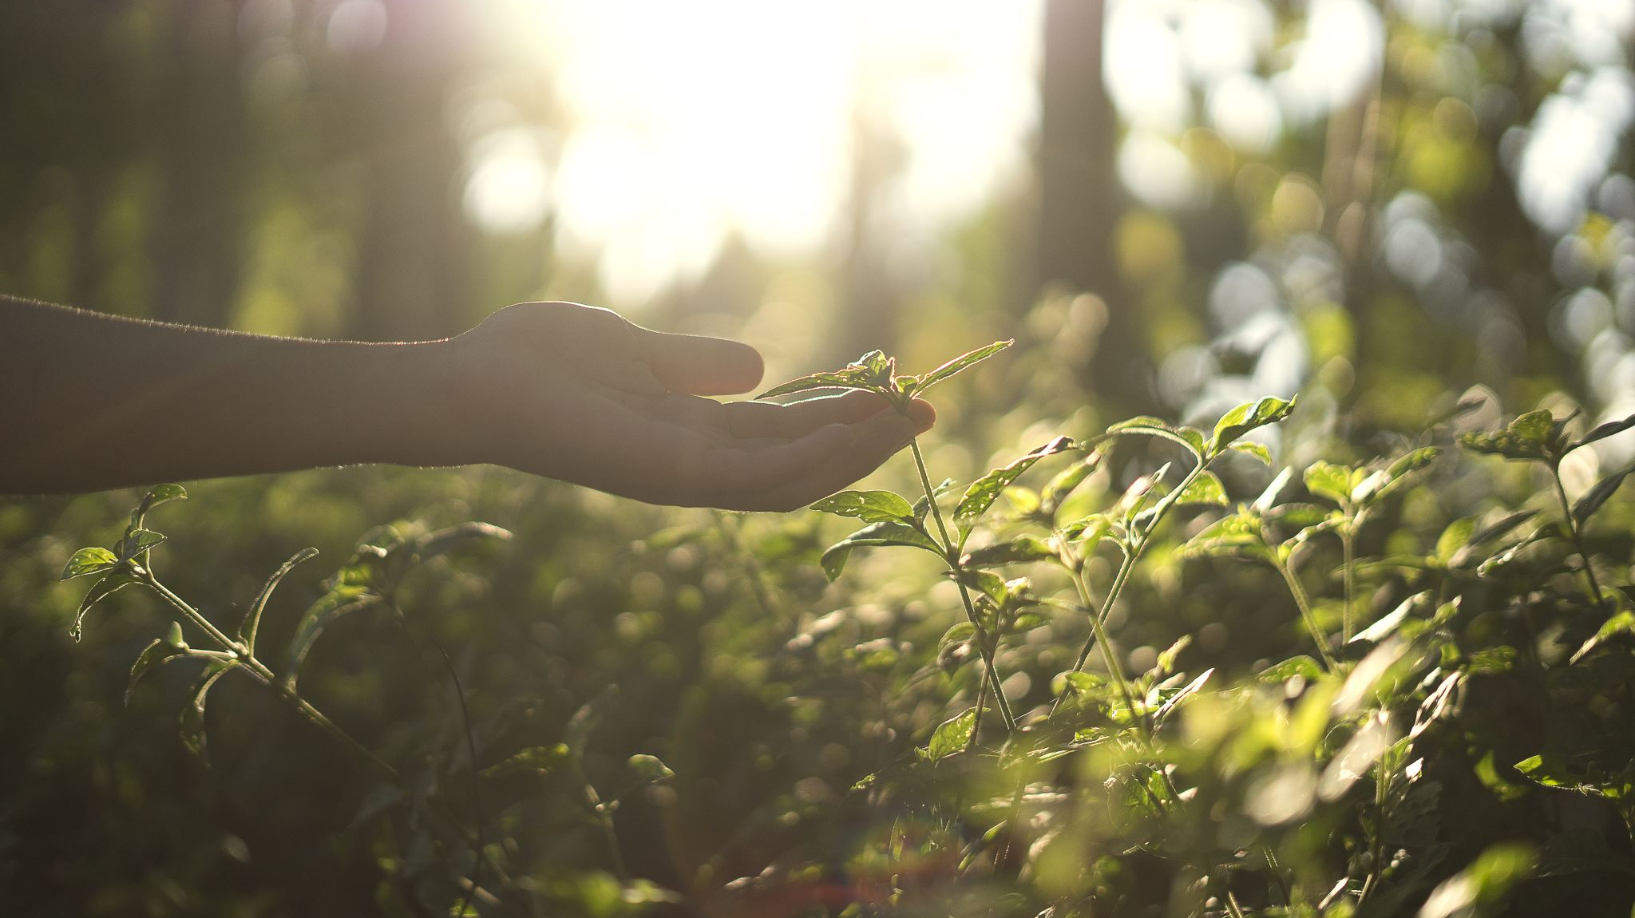
THANK YOU

